Slide 1
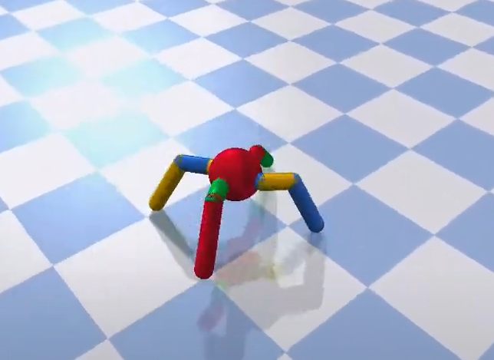
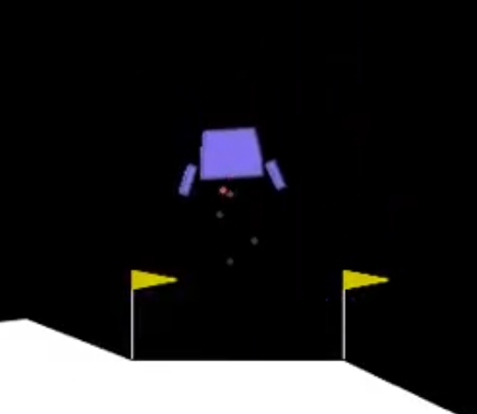
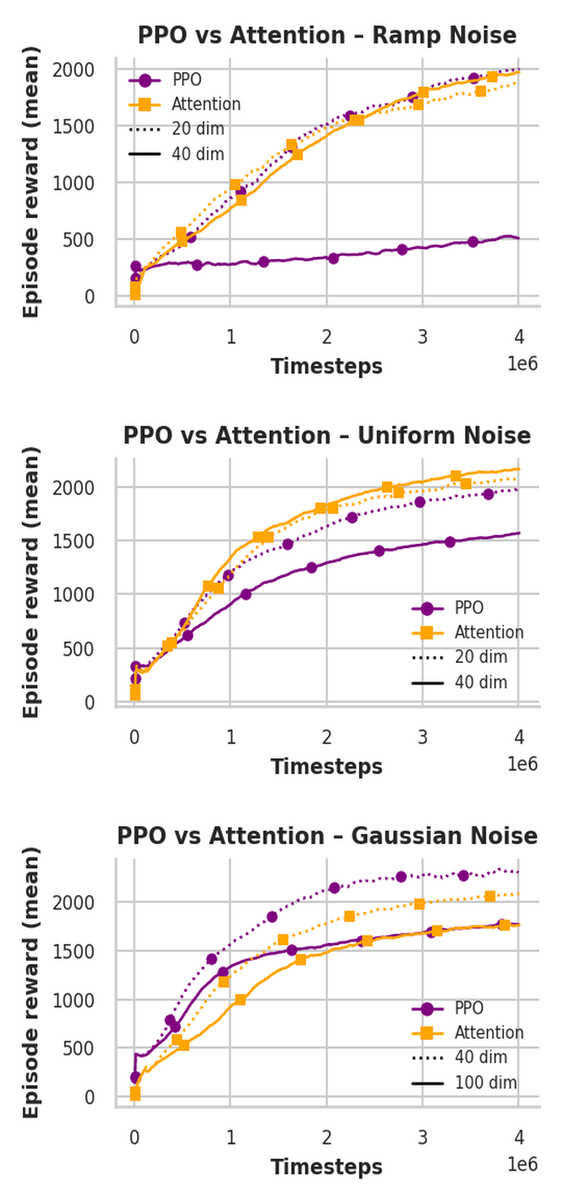
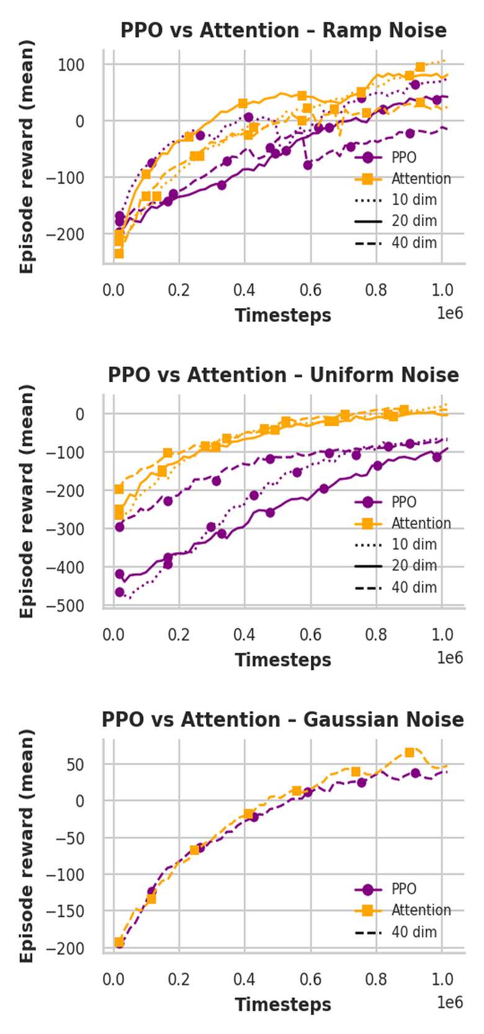
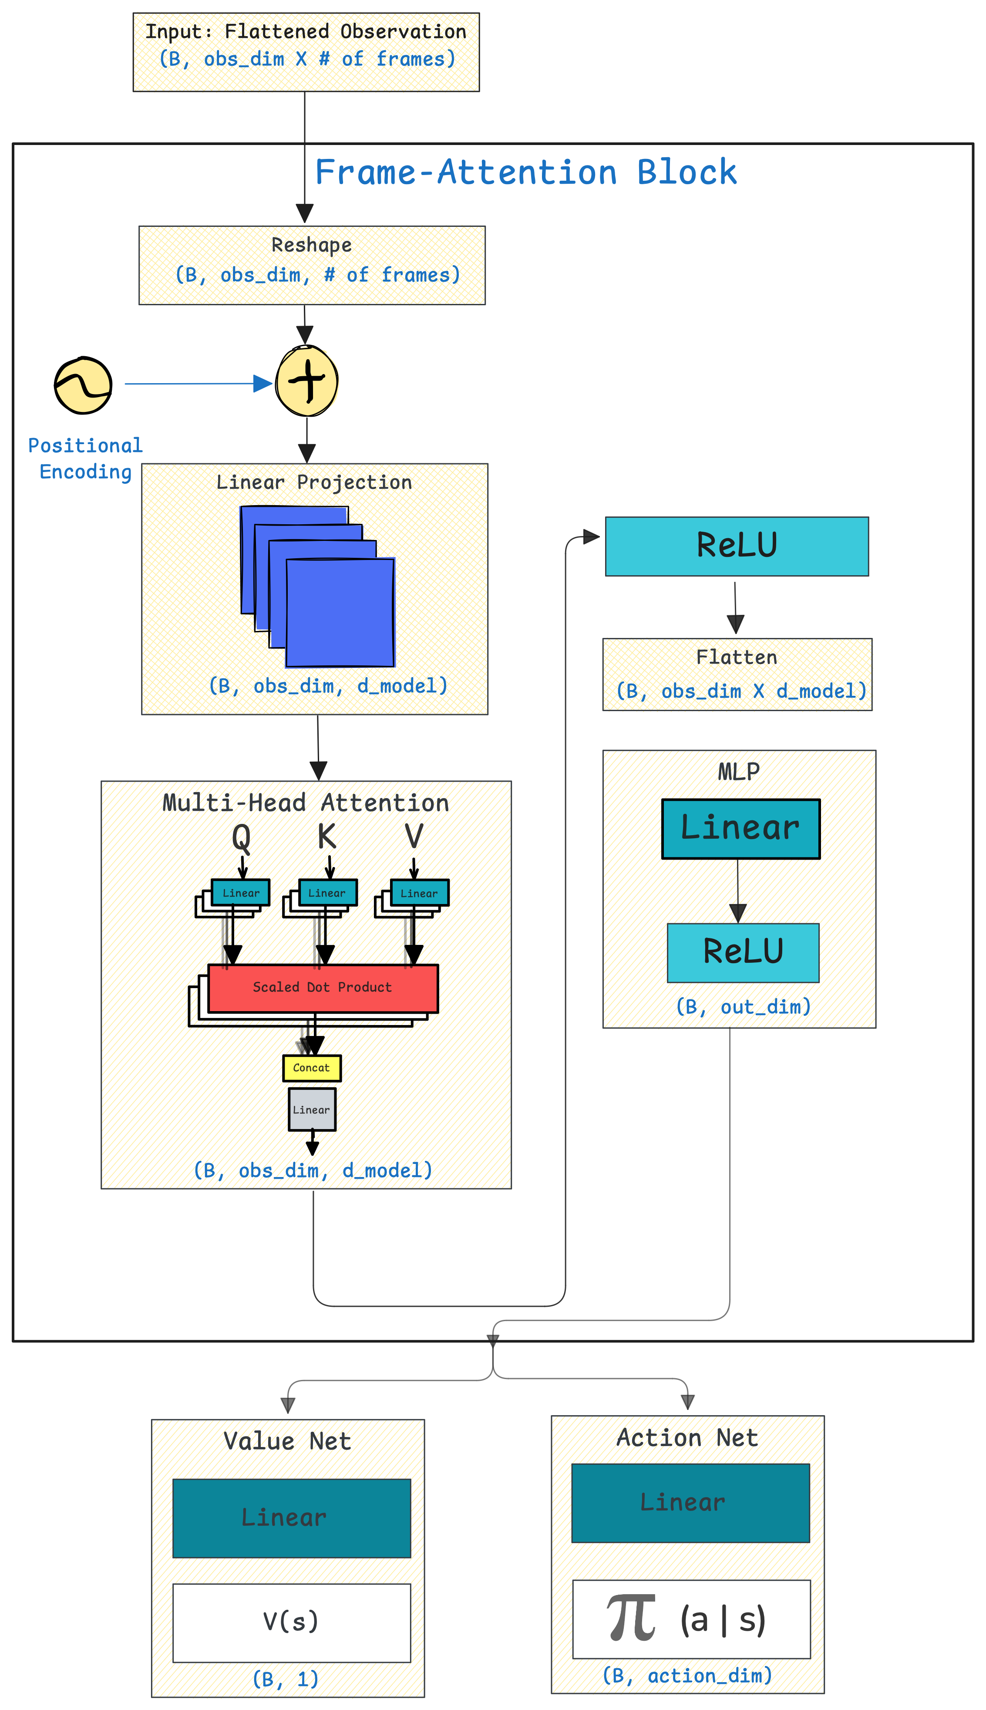
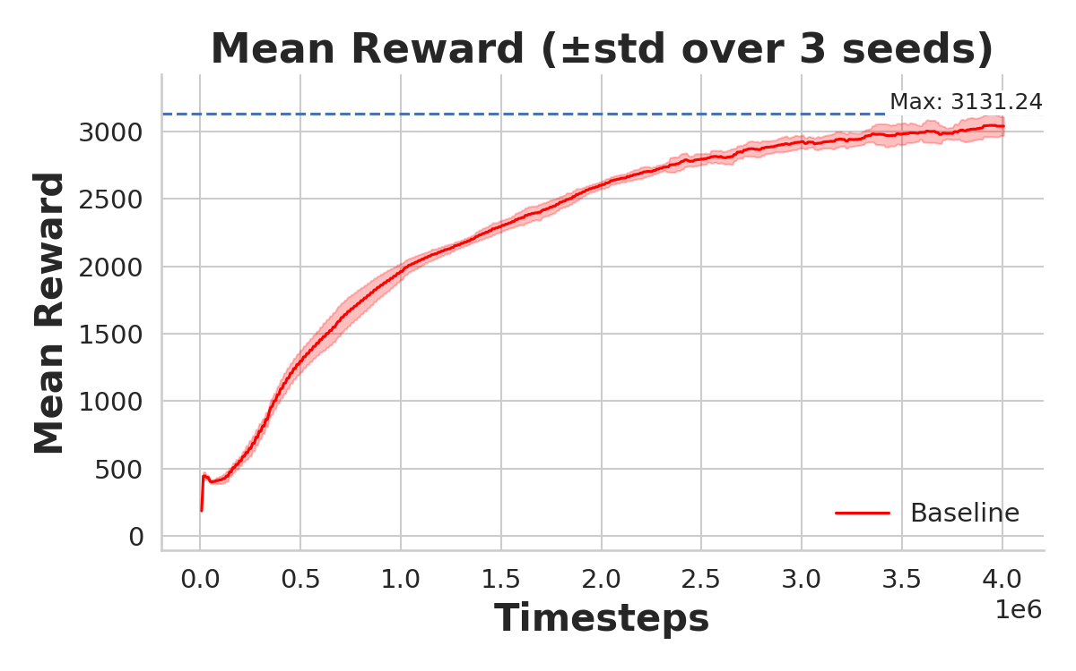
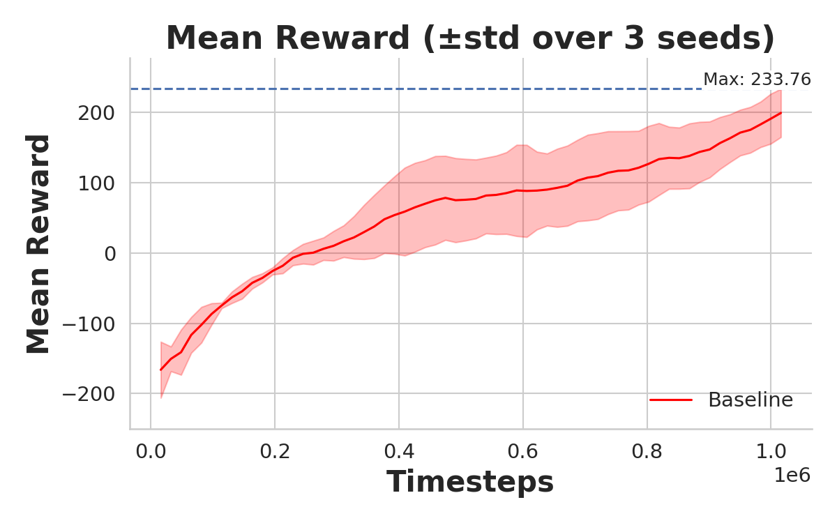
Team 01
CIT433027
Learning What Matters: A Problem in Robotic
Reinforcement Learning
Baran Ozer Serife Damla Konur
Technical University of Munich
{baran.oezer, konur.damla}@tum.de
Ant Bullet
Lunar Lander
Simulation Environments
Attention Architecture Investigation
Frame-stack size = 4 selected
Progressively added and ablated self-attention mechanisms
Feature-wise
Bottlenecked
Hard-gated
Temporal
Different variants replaced the default MLP in value and/or policy nets
To see which design best preserves performence under noise
Results
AntBulletEnv-v0
LunarLanderContinuous-v3
Feature-Attention
Insert self-attention block inside every single observation frame
Lets network learn correlations among raw features
Selective-Attention
Insert self-attention block inside every single observation frame
The output is squeezed through​ a bottleneck
Forces network to compress useful features
Challenge
Equip Proximal Policy Optimization (PPO) with self-attention to ignore noise injected into observations
Curriculum
Baseline establisment with vanilla PPO
Obtain upper-bound performance
Integrate frame-stacking
Integrate self-attention mechanism
Evaluate performance against baseline
Hard-Gated Attention
Attended value overwrites the original feature
Forces network to replace noisy dimensions instead of re-weighting
Frame-Attention
Treats every stacked frame as a token
Applies temporal attention across frame-stacked observations
Proposed Network Architecture
Evaluation Against Baseline
Policy Architecture:
Frame Attention Policy
Observation Input:
Frame-stack size = 4
Evaluation Protocol:
3 seeds per setting, identical PPO hyper-parameters
Ablations:
Different noise types
Different number of noisy dimensions
Noise Injection:
Ramp noise: Linearly increasing by 0.001 at each step, resetting to zero after episode termination
Uniform noise: Random noise sampled per feature from the range [-10, 10]
Gaussian noise: Gaussian noise sampled per feature with std=1
Ant Bullet
Lunar Lander
Baseline
Conclusion / Success Factors
Frame Attention improves PPO robustness under ramp and uniform noise
Enables dynamic noise filtering
Integrates cleanly into standard RL pipelines with minimal overhead
Future
Improve performance under Gaussian noise
Deploy on real robots with real-world sensor noise

